Slide 1
Enhance Teaching-Learning using Classroom Screen
Dr. Meenakshi Rathi
Assistant Professor, Commerce,
Institute for Excellence in Higher Education.
Bhopal Madhya Pradesh

Slide 2
Classroomscreen……????
ClassroomScreen is a web-based application designed to simplify classroom management and create an optimal learning environment. It offers a range of tools and features that can be accessed with ease, making it suitable for teachers of all tech proficiency levels. Its features are tailored to support teachers in creating an interactive and organized learning environment.
क्लासरूमस्क्रीन एक वेब-आधारित एप्लिकेशन है जिसे कक्षा प्रबंधन को सरल बनाने के लिए उपयोग किया जाता है । यह कई प्रकार की सुविधाएँ प्रदान करता है जिन्हें आसानी से एक्सेस किया जा सकता है, जिससे यह सभी तकनीकी दक्षता स्तरों के शिक्षकों के लिए उपयुक्त हो जाता है। इसकी विशेषताएं एक इंटरैक्टिव और संगठित सीखने के माहौल बनाने में शिक्षकों के लिए तैयार की गई हैं।

Slide 3
Features of Classroomscreen….
Communication/ Connection Tools – Platforms for online & offline connectivity
Interactive Teaching Tools - For better engagement and learners interaction in real time.
Collaboration Tool - For effective Resource Sharing, Problem solving and Linkages, QR Code
Classroom Management Tool – Random Student Selection, Traffic light
Assessment Tools – Poll, Quiz, Clock control etc.

Slide 4
This Session is about All-in One Bundle……
www.classroomscreen.com

Slide 5
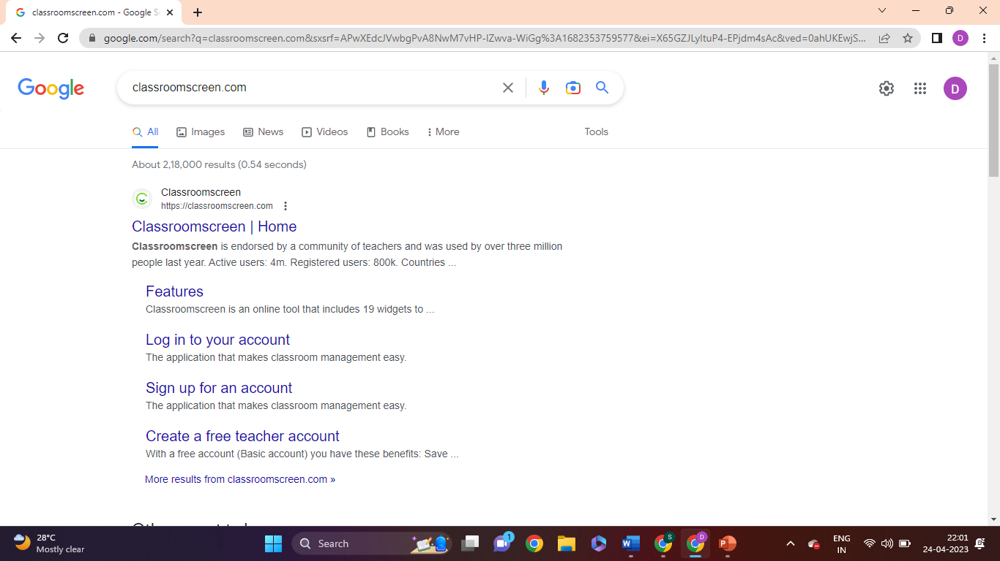

Slide 6
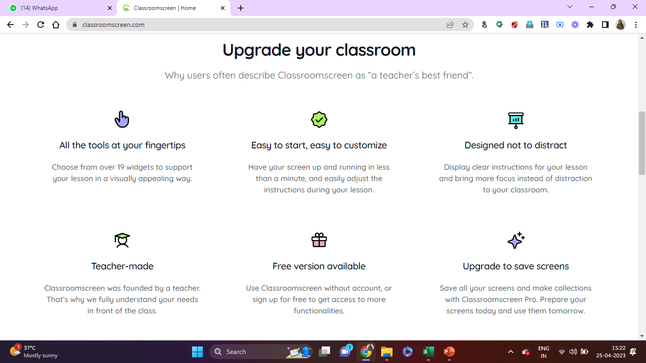

Slide 7
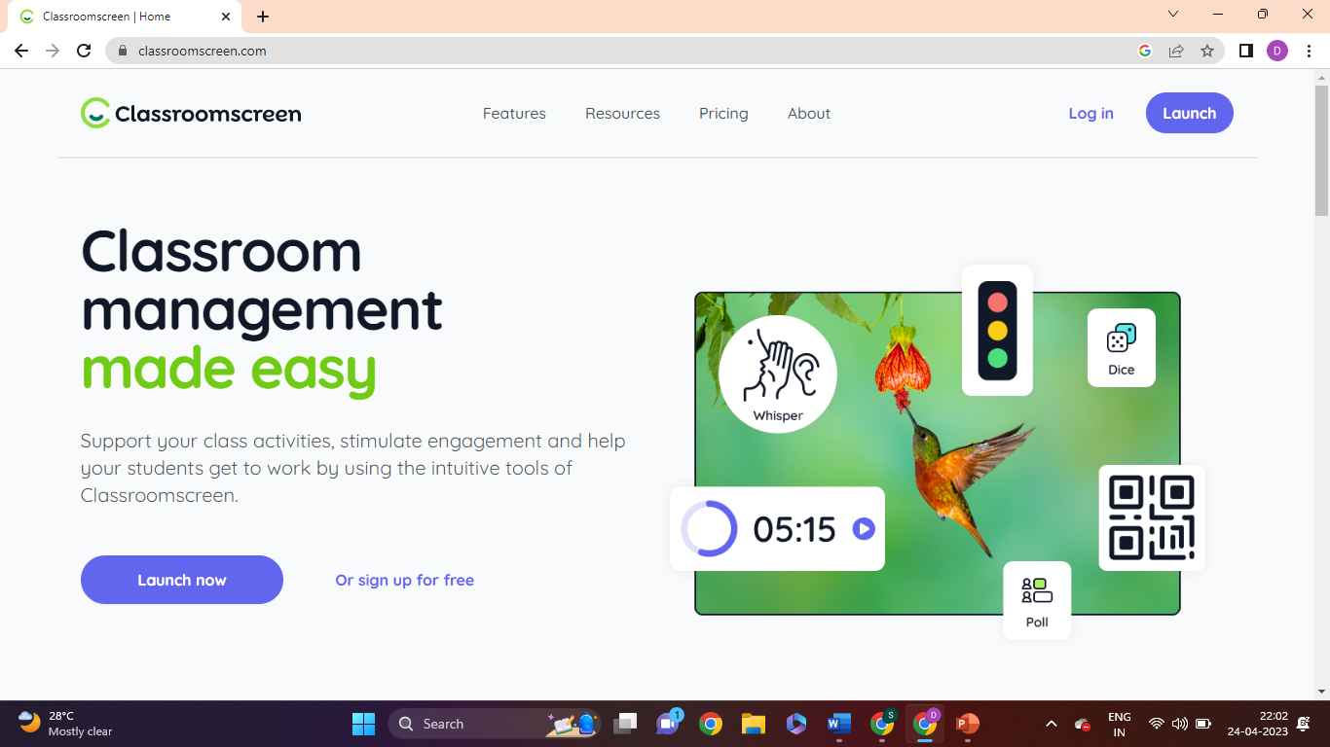

Slide 8
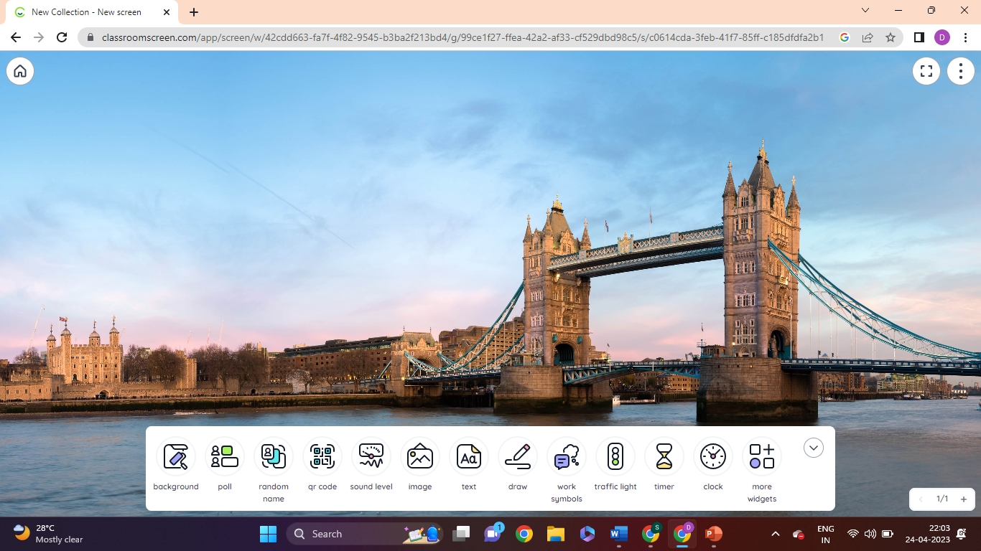
19 Widgets available

Slide 9
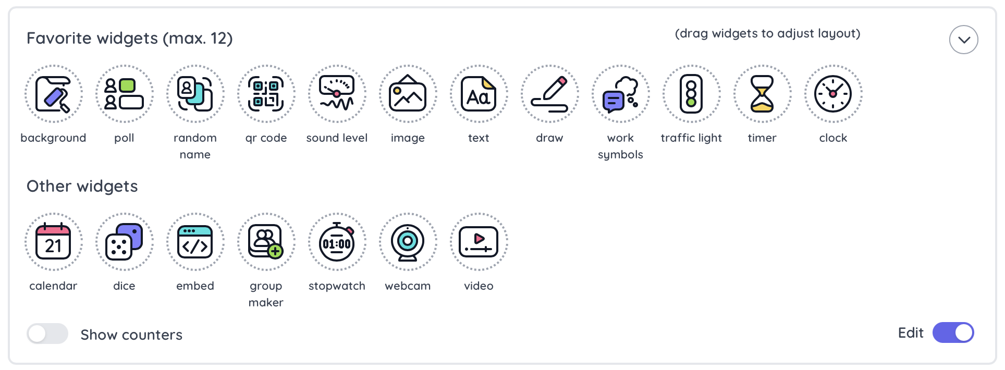
Widgets available here

Slide 10
QR Code
Timer
Webcam
Calendar
Embed
QR Code
Random Name
Text
Work Symbols
Poll
Group Maker
Dice
Sound Level
Traffic Light
Video
Image
Timer
Draw

Slide 11
Lets do some hands-on
www.classroomscreen.com

Slide 12
E-Content
Future Scope
Blended Learning
Collaborative Teaching- Learning
Usage of Multimedia /Graphics/ GIFs /Animation/ Podcast/ Videos/ Audios
Growth of OER (Open Education Resource)
3 A’s of Learning (Anyone, Anytime, AnyWhere)
MOOCs and META Universities
Learner Centric (Increased Student Role)

Slide 13
Thankyou
Dr. Meenakshi Rathi
Mob: 9907078080
drmeenakshirathi01@gmail.com
drmeenakshirathi@mp.gov.in

Slide 14
Never Stop Learning…………
Because Life Never Stops Teaching.

